Slide 1



MTailor
COMPANY
Your paragraph text
PROFILE
Mtailor is a tech-driven clothing brand offering custom-tailored apparel through a mobile app. Using advanced measurement technology, they create personalized, high-quality garments for a unique and stylish fit. The company has attracted investor including Y combinator and Khosla ventures.

Slide 2
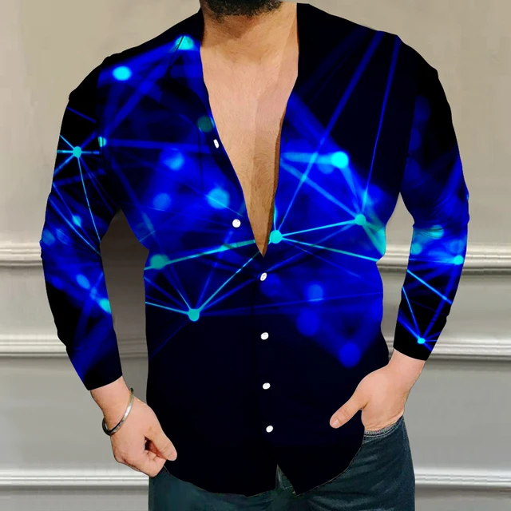
ABOUT US
Mtailor revolutionizes the fashion experience with cutting-edge technology, offering personalized, custom-tailored apparel through our mobile app. Blending innovation and craftsmanship, ensuring each garment reflects individual style.
https://www.mtailor.com/about-us

Slide 3
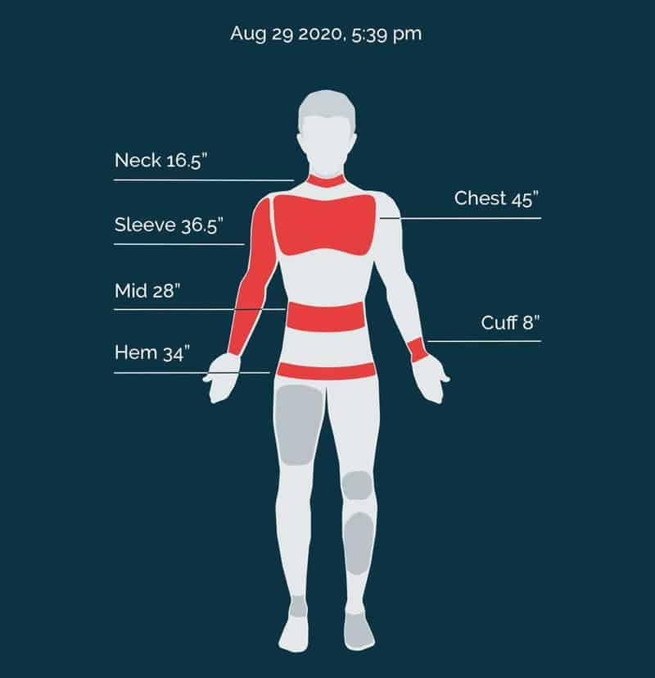
Mtailor Technology
Mtailor's technology is an advanced platform that revolutionizes custom clothing. Using cutting-edge AI, it precisely captures body measurements through a mobile app, creating a seamless virtual fitting experience for personalized and innovative fashion solutions. This AI Technology is 20% more accurate than a professional tailor.

Slide 4
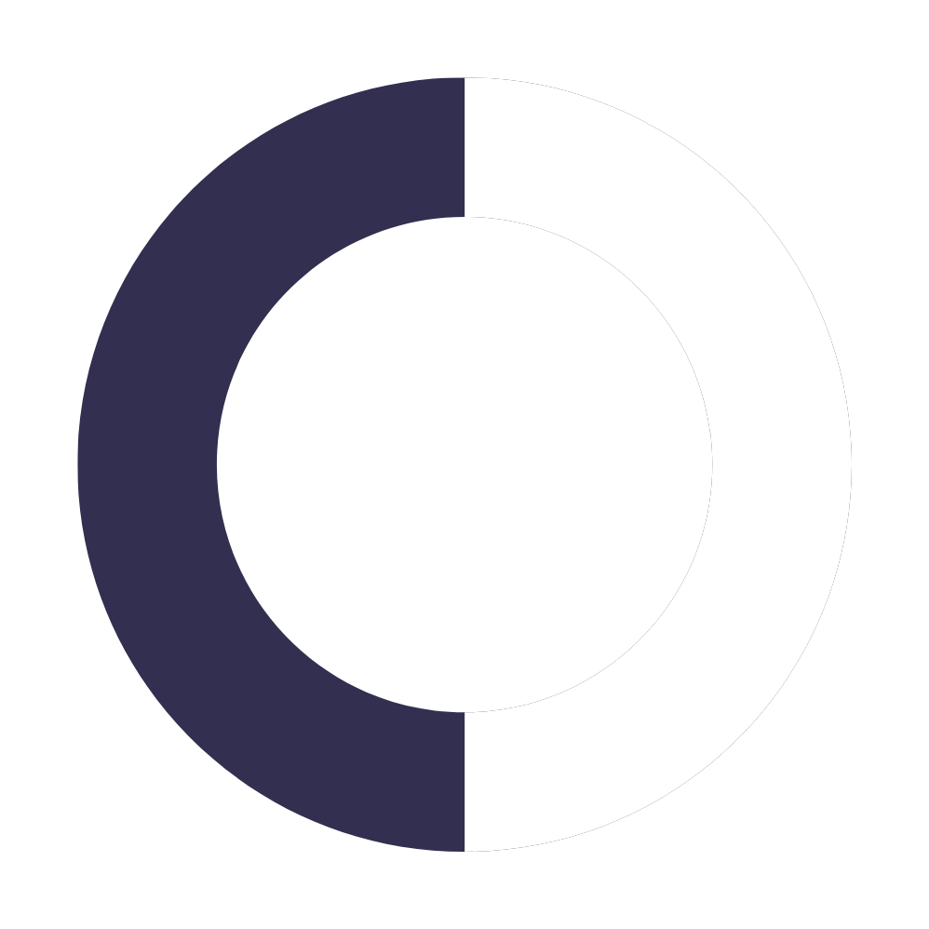
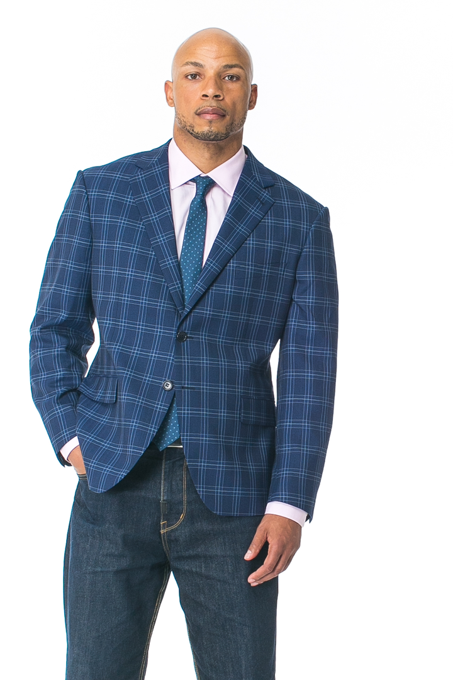
VISION
Pioneering Unmatched Style
Revolutionizing global closets with leading-edge technology, envisaging a world where individuality thrives through uniquely tailored, effortlessly chic fashion experiences.

Slide 5
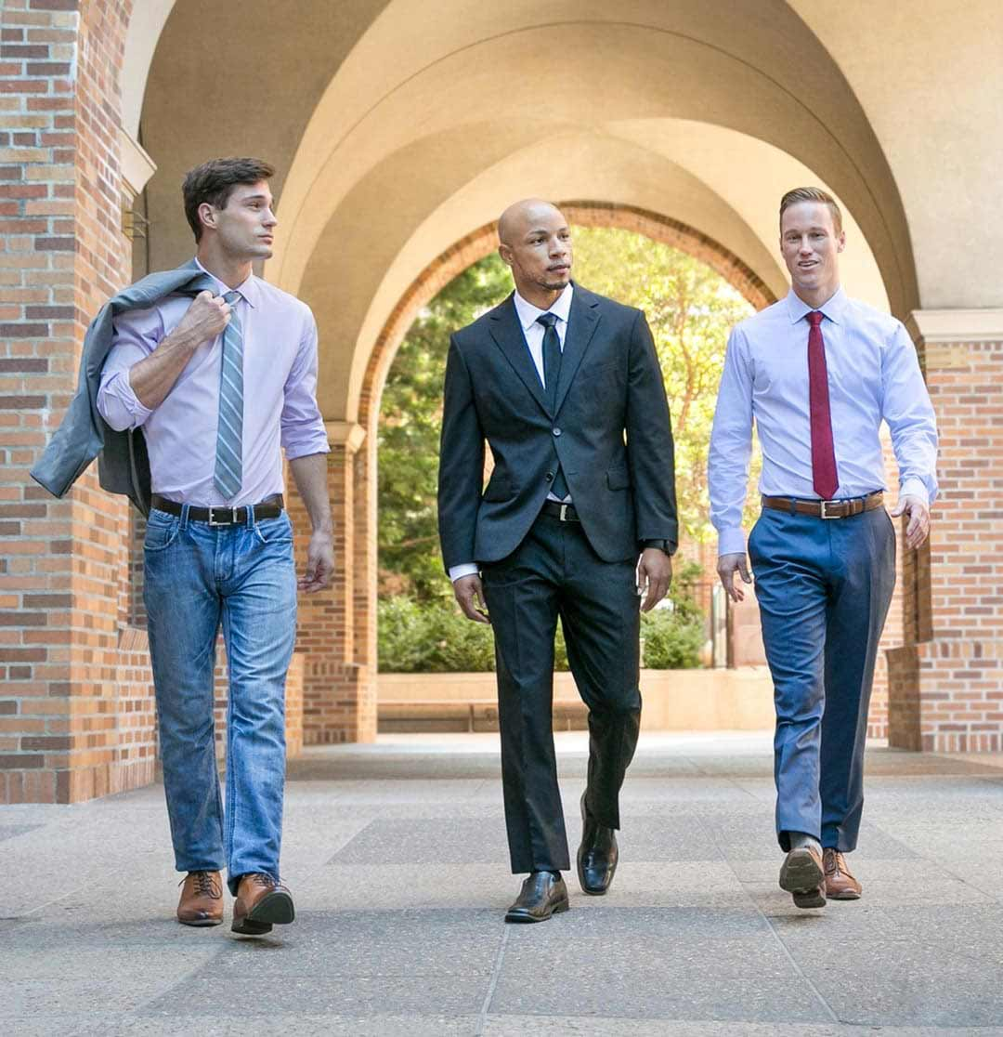
MISSION
Empower individuals to embrace their uniqueness by providing accessible, high-quality, and custom-tailored clothing, driven by innovation, craftsmanship, and a commitment to personalized excellence.
READ MORE

Slide 6
Core Values
OUR TEAM
Data And Testin
Customer-Focused Mindset
Teamwork
Continual Growth
g
CULTURE
Scientists at Heart
At MTailor, the focus is on constructing the world's most precise body measurement technology, seamlessly integrated with in-house clothing production. Machine learning models ensure measurements surpass traditional tailoring accuracy, advocating that every customer deserves an impeccable fit.

Slide 7
MILESTONE
Mtailor was founded, introducing the concept of custom-tailored clothing through a mobile app, revolutionizing the traditional fashion industry.
Diversified product offerings to include a wide range of apparel, expanding beyond shirts to meet growing customer demand for custom-tailored clothing.
2013
2018
Achieved a significant milestone by developing and implementing cutting-edge measurement technology for accurate and personalized fittings.
Continued technological advancements, enhancing the app's features to improve user experience, including more precise measurements and an expanded catalog of customizable styles.
2015
2020
Launched the Mtailor app, providing users with a user-friendly platform to seamlessly measure themselves and order bespoke garments with ease.
Garnered global recognition for innovation in the fashion-tech space, solidifying Mtailor's position as a leader in personalized, tech-driven apparel. as of 2023, the annual revenue has exceeded USD 5 million.
2016
2023

Slide 8


Miles Penn
OUR TEAM
TEAM
Miles Penn is CEO of MTailor; he cofounded his business at the age of 23. Miles graduated from Stanford University and currently resides in San Francisco. Miles Penn has been recognized by Forbes 30 Under 30 List
Mtailor's dynamic team comprises tech innovators, fashion experts, and dedicated professionals united by a passion for transforming the apparel industry. Together, they redefine personalized fashion through cutting-edge technology and creativity.
JORDAN KNAPP
Jordan Knapp, based in Salt Lake City, UT, US, is currently a VP of Engineering at MTailor, bringing experience from previous roles at MTailor, Redfin and Knappster Labs, LLC

Slide 9

INCLUSION
if Diversity != Strength:
print("ALERT")
Cultural Mosaic
Equal Opportunities
Global Workforce/ Fully Remote
Listening and Learning

Slide 10
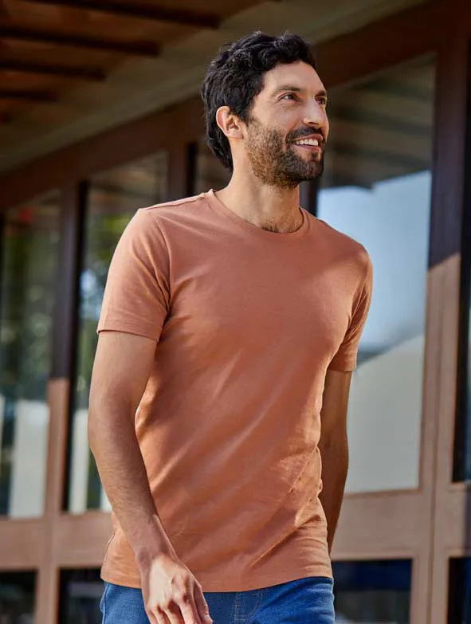
20% More Accurate Than A Tailor
01
02
We Make Clothes For You
03
Affordable And Free Shipping
MTAILOR’S
SERVICE
04
Shop At Home

Slide 11
PROCESS
Measurement Technology
01
Users download the Mtailor app, where advanced measurement technology guides them through a simple process to capture precise body measurements using their smartphone's camera.
01
02
Customization and Style Selection
After measurements are submitted, customers navigate the app to select their preferred style, fabric, and design details. The platform offers a diverse range of options to create a truly personalized garment.
02
Craftsmanship and Delivery
03
Mtailor's skilled craftsmen in Bangladesh then utilize the measurements and design choices to create a custom-tailored garment. The finished product is shipped directly to the customer, ensuring a unique, high-quality, and perfectly fitted piece of clothing.
03

Slide 12
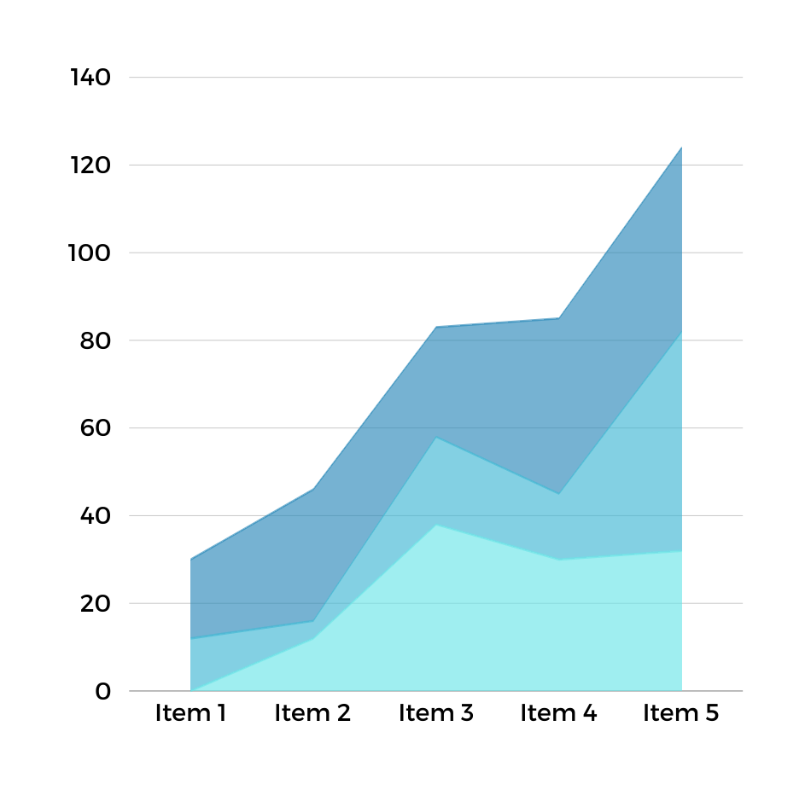
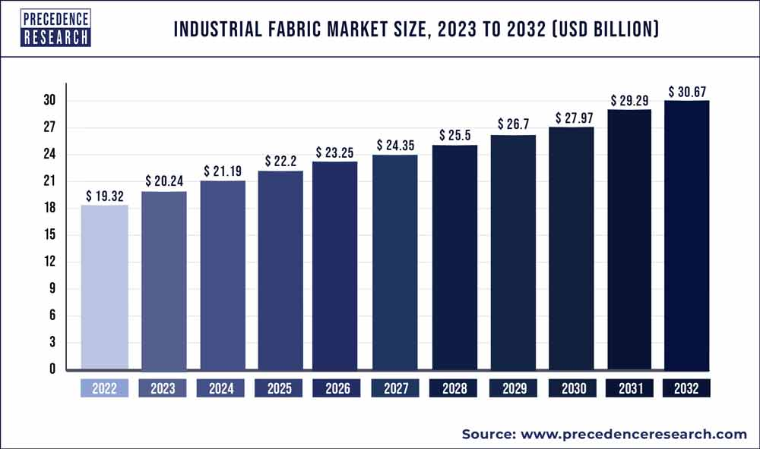
MARKET ANALYSIS
Mtailor operates in a dynamic market fueled by the increasing demand for personalized fashion. With a focus on innovative technology, the company taps into the growing trend of custom-tailored clothing. This positions Mtailor strategically, appealing to consumers seeking unique, high-quality garments in the evolving fashion landscape.

Slide 13
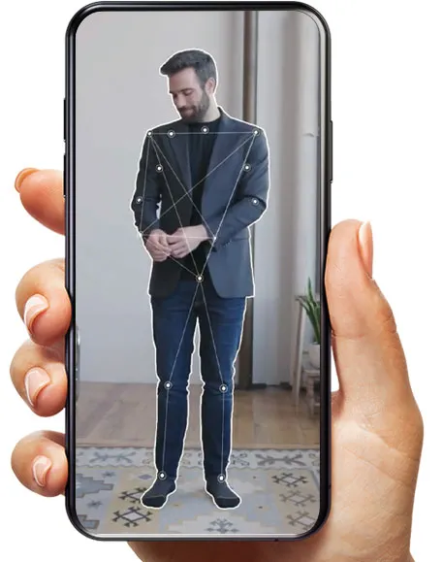
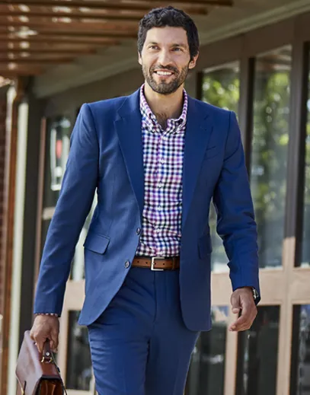
COMPANY GOALS
Mtailor's goals center on revolutionizing personalized fashion through technology. We aim to expand our global footprint, enhance our app with cutting-edge features, and remain at the forefront of sustainability. Our mission is to empower individuals with unique, perfectly fitted garments and an unparalleled customization experience.

Slide 14


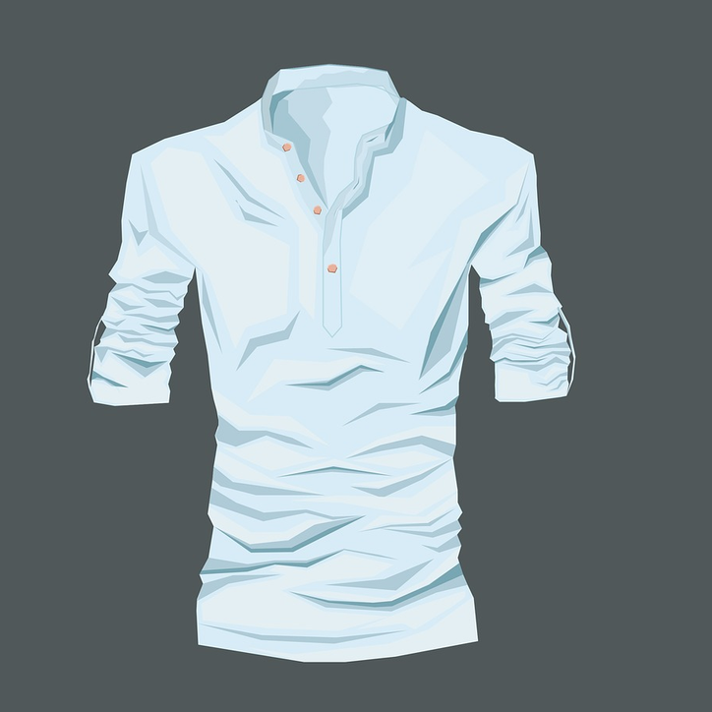

CURRENT PROJECT
Mtailor is set to introduce its imminent project, which will bring state-of-the-art 3D visualization and rendering technologies to the forefront.This innovation enhances the customization experience, offering users a realistic preview of their personalized garments. A groundbreaking step in redefining how individuals engage with and visualize their distinct styles.

Slide 15
Innovative Atmosphere
Collaborative Culture
Technology-Driven Workspace
Recognition of Individuality
Motivations to Join Mtailor
Joining Mtailor means entering a realm of innovation, where cutting-edge technology meets personalized fashion. Here, I'll contribute to revolutionizing the industry, creating unique styles, and delivering perfect fits.

Slide 16
Cultural Fit
Key Takeways
1. Innovation-driven customer-centricity.
2. Empowering self-driven professional growth.
3. Collaborative culture fosters team synergy.
4. Adaptable mindset embraces continuous learning.
5. Goal-oriented ethos propels organizational success.
My qualities align seamlessly with Mtailor's culture and goals. Through innovation, customer-centricity, and a self-driven mindset, I can contribute effectively to the company's success. Embracing continuous learning, I am poised to play a pivotal role in advancing our shared objectives.

Slide 17

My Value Proposition
This is the value i bring to Mtailor
Collaborative and team-focused demeanor.
Continuous Learning and Practice mindset
Experience and certification
in Data analytics
Experience and certifications in sales management
Experience and certifications in business
development and business operation
Experience and certification in finance &
quantitative modelling
Entrepreneurship and innovation- submitted
proposals to different companies.
Proposal for countering IDFA effect in marketing

